Slide 1
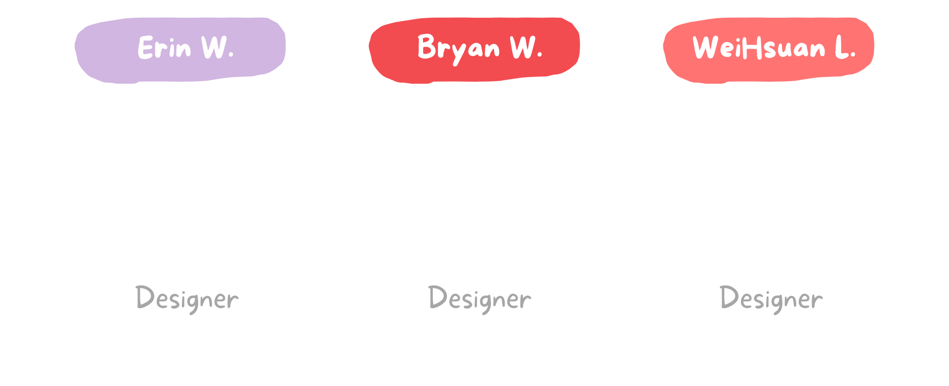
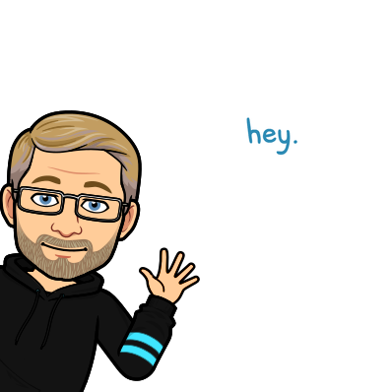
Team Ed Tech

Slide 2
Pre or in-service teachers need engaging professional development on
Social Emotional Learning &
Related Teaching Techniques.

Slide 3
How do teach educators correct responses to students behaviors?
Is there a correct response to different actions and how can teachers best handle classroom management?

Slide 4
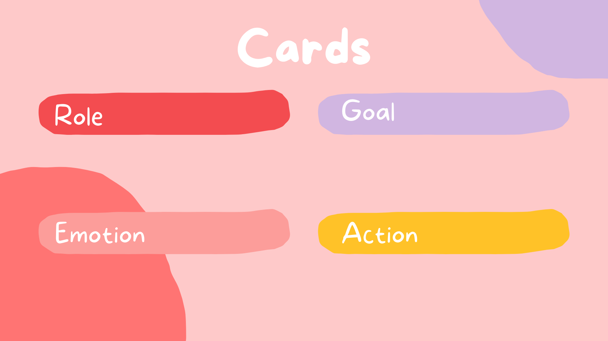
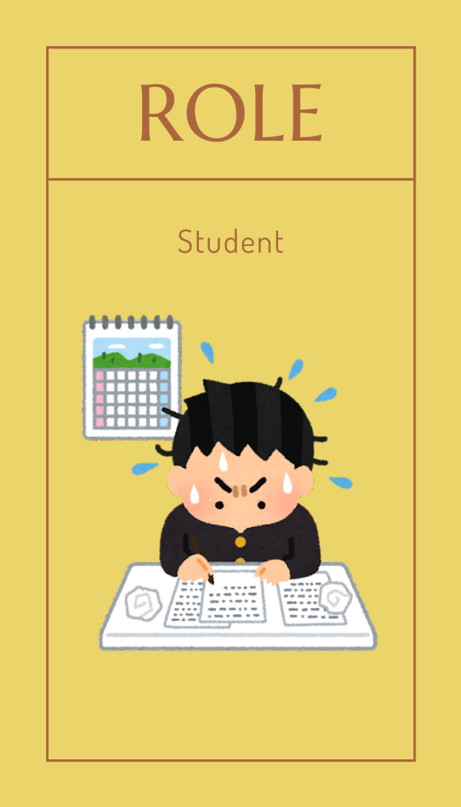

Slide 5
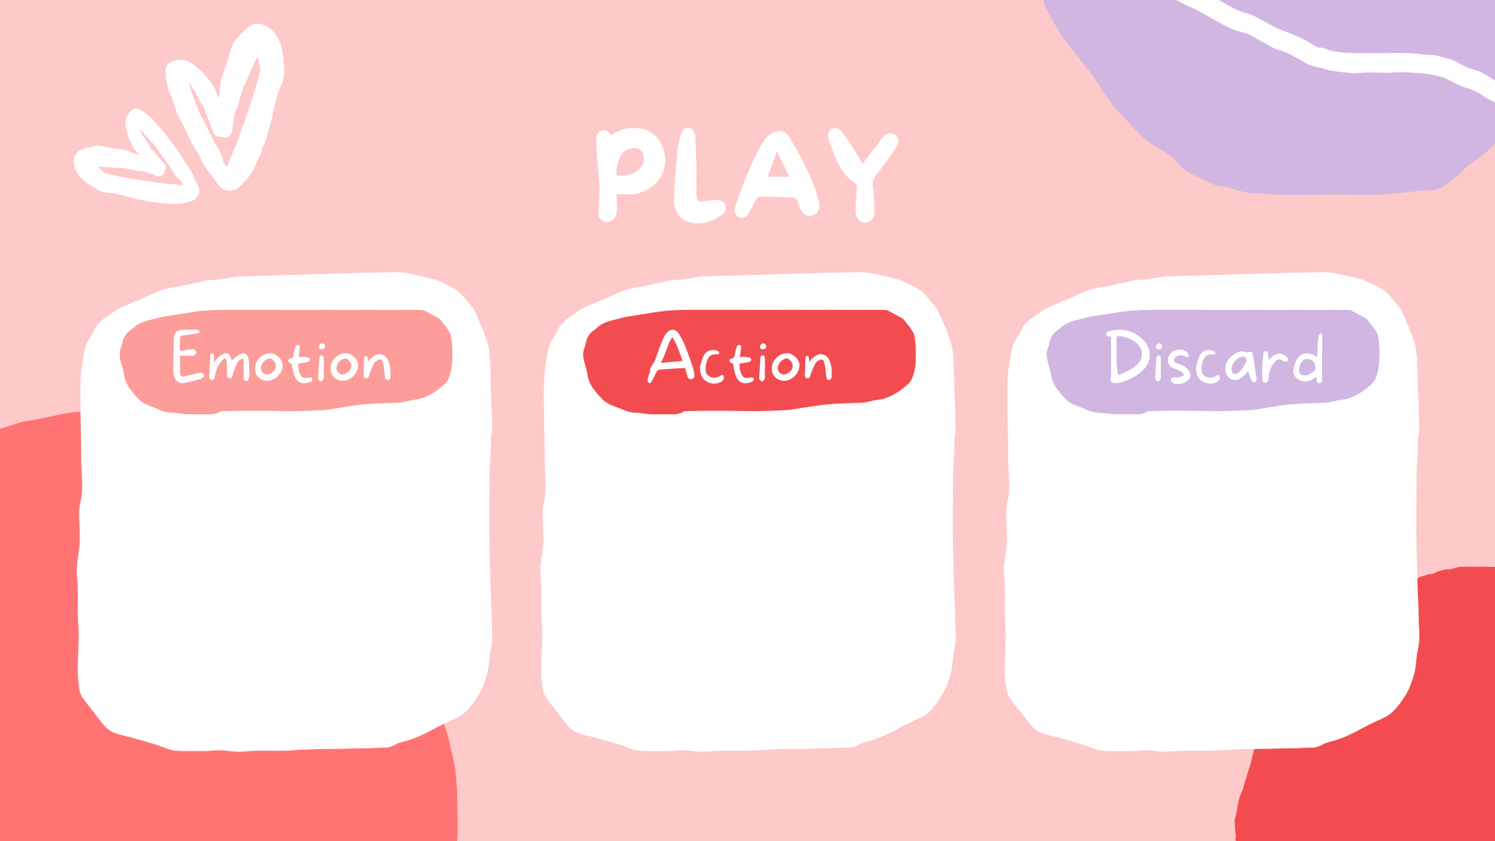
I am feeling “HAPPY.”
Explain why “Strategy” works.
Discard and Draw

Slide 6
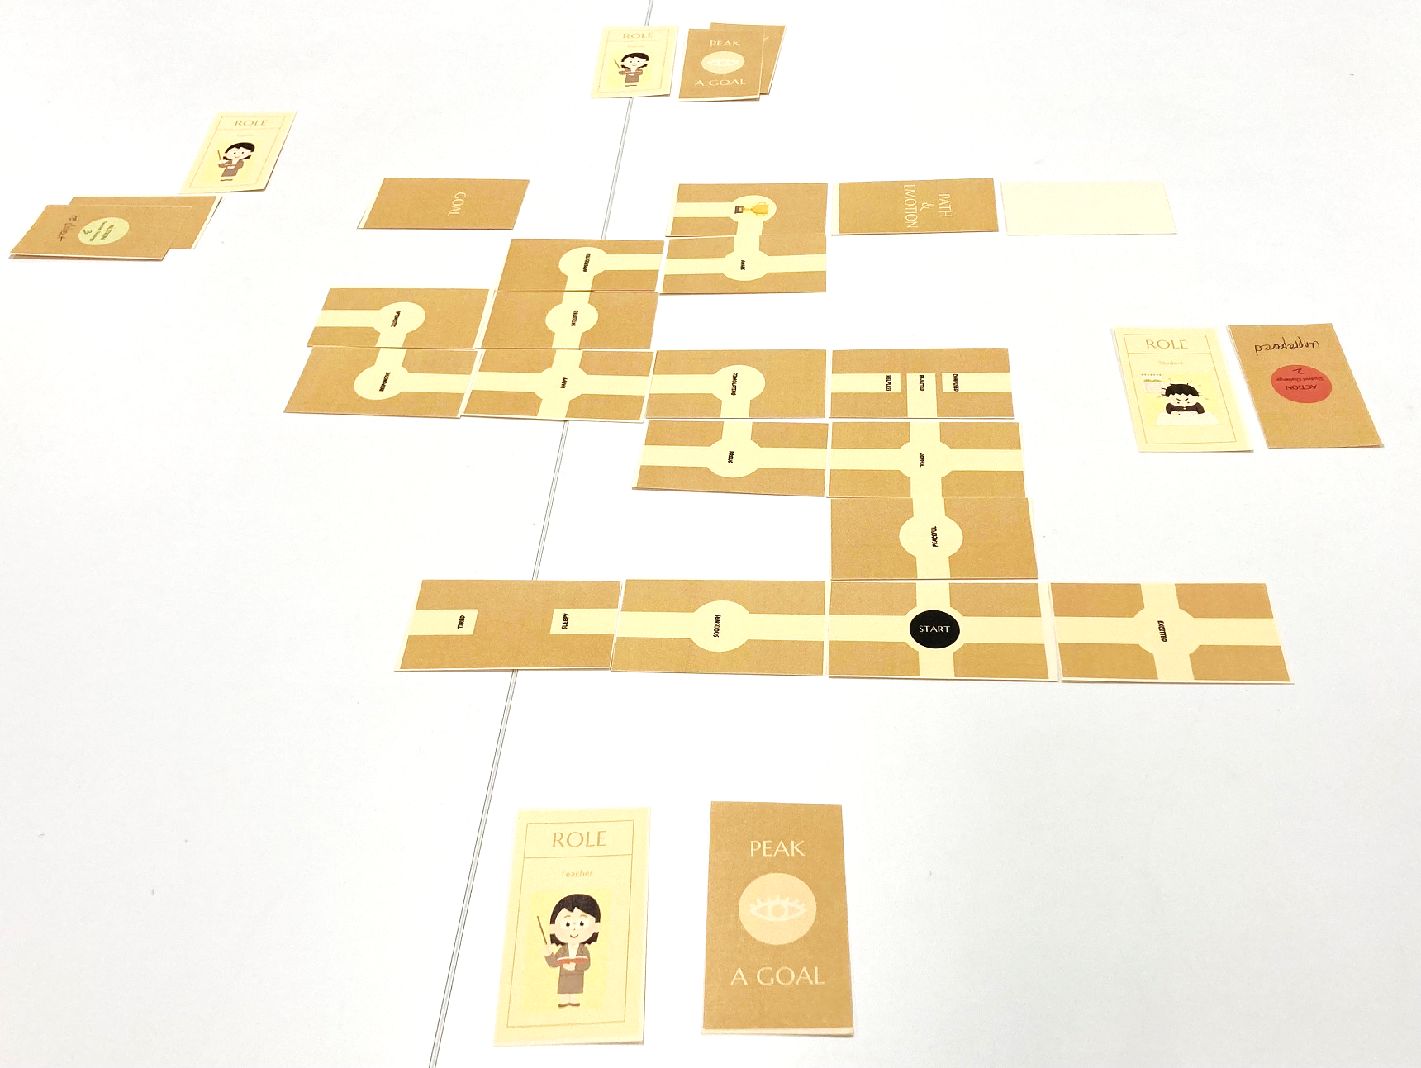
[Print to Play]

